Slide 1
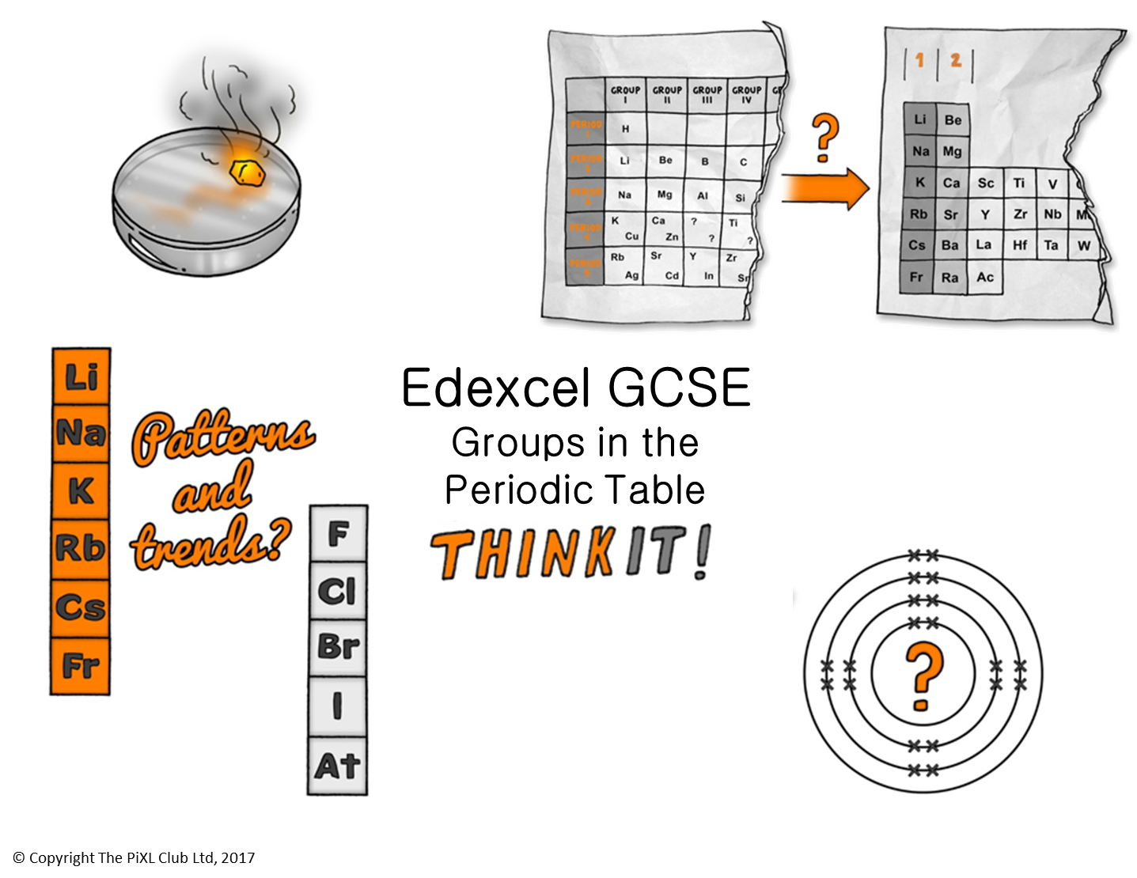

Slide 2
Group 1:
Evaluate the statement "Hydrogen should be placed in Group 1 of the periodic table“.
Describe and explain the pattern in reactivity of the alkali metals with water.
Predict the reactivity of caesium with water; write a balanced symbol equation for this reaction.
In terms of electrons, explain how alkali metals react with halogens.
Group 7:
Describe the pattern in the physical properties of the halogens, chlorine, iodine and bromine. Include the colours and physical states in your response.
Predict the physical properties of astatine.
Explain why displacement reactions are redox reactions in terms of gain and loss of electrons.
Group 0:
Explain why noble gases are chemically inert.
Describe the physical properties of helium, neon and argon and use this pattern to predict the physical properties of krypton.
Explain why noble gases are monoatomic.
Explain why argon is used as the gas inside filament bulbs.
Group 1 and 7:
Explain the relative reactivity of the halogens in terms of electronic configuration.
Why does iodine have a higher boiling point than chlorine?
Why are potassium and lithium in the same Group of the periodic table?
Using an example, identify which of the substances is oxidised and which reduced in a displacement reaction.
Metals and non metals:
Germanium reacts with acids to form a salt and water, it is a semi-conductor, has a melting point of 937°C and reacts with chlorine to from GeCl₄. Justify whether you think Germanium is a metal or non-metal.
Discuss the effects of atomic radius and shielding on the reactivity of group 1 and 7 elements.
Explain what happens when a solution of bromine is mixed with sodium iodide solution.
Edexcel GCSE Groups in the Periodic Table
ThinkIT!
© Copyright The PiXL Club Ltd, 2017
Electronic structure:
Explain how the position of an element in the periodic table is related to the arrangement of electrons in its atoms.
Describe how to calculate an element’s electronic structure.
Explain why the number of bonds an atom can form depends on the number of electrons available.
Reactions:
Describe the chemical test for chlorine.
Design a practical to investigate the displacement reactions of halogens reacting with halide ions in solution.
Write a balanced symbol equation for the reaction between sodium and chlorine; explain what is happening in terms of electrons using a diagram; draw a diagram of the resulting ionic compound.
The periodic table:
How would you explain the structure of the modern periodic table to John Newlands?
Explain how Dmitri Mendeleev used atomic weights to construct his periodic table and explain why scientists came to believe Mendeleev's periodic table?

